Slide 1
Introduction
Player safety is paramount to all playing rules!
To minimize the inherent risk of injury, the National Federation of State High School Associations writes playing rules for varsity competition among student-athletes of high school age. Modifications may be appropriate for children who are younger or less skilled than high school varsity athletes.
Each state high school association adopting these rules is the sole and exclusive source of binding rules interpretations for contests involving its member schools. Any person having questions about the interpretation of NFHS rules should contact the rules interpreter designated by his or her association. CUA rule interpreter is Jay Kobylarz
The NFHS does not perform scientific tests on any specific items of equipment to determine if the equipment poses undue risks to student-athletes, coaches, officials or spectators. Such determinations are the responsibility of equipment manufacturers.

Slide 2
RULE 1… PLAYERS, FIELD and EQUIPMENT

Slide 3
Section 1 Positions of Players Article 1
Teams Must start with 9 players but may finish with only 8. If there are 8 players, the missing player is an out each time that at bat occurs. If a ninth player arrives, that player can be put in the missing spot in the lineup (Exception 4-4-1f)
Rule 4 Starting and Ending Game
Section 4 FORFEITED GAME
Art 1… A game shall be forfeited to the offended team by the umpire when a team:
f. Is unable to provide at least nine players to start the game or cannot provide eight players to finish the game; or
Notes:
1. An out will be called each time that spot in the batting order comes to bat. If the offensive player must be substituted for after reaching base, the most recent batter not on base is allowed to run for that player.
2. A team with fewer than nine players may return to nine players.

Slide 4
Section 1 Positions of Players Article 2 and 4
Section 1 POSITIONS OF PLAYERS
Art 2… The captain and head coach represent the team in communications with umpires. The captain and head coach’s duties shall include:
***This is why we do not converse with Assistant Coaches
1) Lineup Card…providing the umpire-in-chief with his team's lineup card which shall include the name, shirt number, position and batting order of each starting player. The name and shirt number of each eligible substitute should also be listed. There is no penalty assessed for failure to list.
**Names are important. Numbers are not.
2) Ground Rules… informing all players as to special ground rules as announced by the umpire-in-chief. Ground rules may not supersede playing rules. Lineups become official after they have been exchanged, verified and then accepted by umpire during the pregame conference.
** Pregame Conference will be covered in Rule 2**
Art 4… At the time of the pitch, all fielders shall be on fair ground except the catcher who shall be in the catcher’s box. A fielder is in fair ground when at least one foot is touching fair ground.
Penalty: Illegal Pitch (2-18)

Slide 5
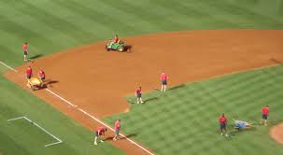
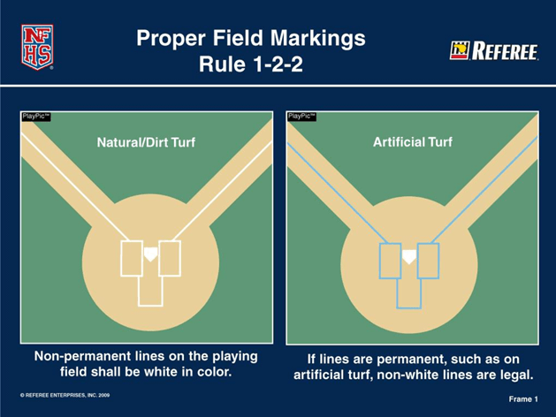
Section 2 The Field
Markings…Art. 2… All lines on the playing field shall be marked with a material which is not injurious to the eyes or skin. All non-permanent lines should be white. Lime or caustic material is prohibited.
**JV and Varsity baseball check the field prior to the game. If the batter’s boxes, on-deck circles, coaching boxes and
running lane are not marked tell them to
mark them. On-deck circles and coach’s
boxes may be a mat, artificial turf or similar.
No coach’s boxes or on-deck circles then no
coaches or on-deck batters allowed on the
field. For MS allow them to play but call
Gary at the conclusion of the game.
On Deck Circle…neither team’s players
may warm up in the other team’s circles.
Exception: PU realizes there is a safety
concern due to poor field confinement.
Allow one on deck batter during live play
and two between innings. 1st Hitter and the batter after him.

Slide 6
Section 2 The Field
Art. 4…When the dugout area is temporarily extended, for any reason, it shall be extended toward the outfield on a line parallel to the foul line. The extension of the dugout area shall be equally applied for both teams.
***Do not let them use the improper extension. Call Gary to inform him at the completion of the game.
Media Area… Establish at pre-game meeting. Umpire can terminate
at any time during the game. Media area should be marked using the same material as foul lines. .
Art. 12…Any game started on a nonregulation facility by mutual agreement of the opposing coaches shall not be protested for this reason.

Slide 7
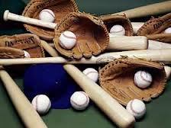
SECTION THREE BATS, BALLS AND GLOVES

Slide 8
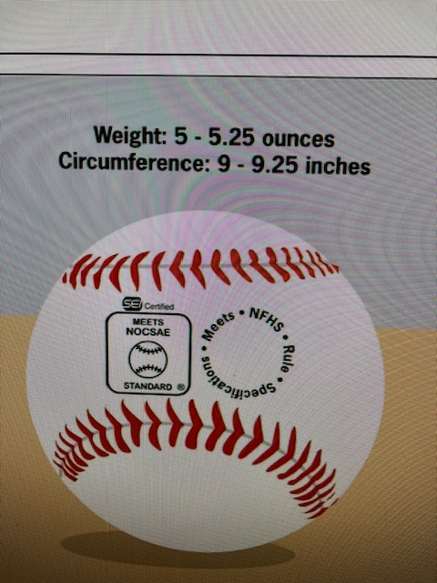
Game Balls- 2025 Point of Emphasis Section 3 Article 1
Rule 1-3-1
Art 1…The ball shall meet the current NOCSAE standard for baseballs at the time of manufacture and is required on balls that will be used in high school competition. The DEI/NOCCSAE mark (below)is required on all balls that meet the NOCSAE standard that will be used in high school competition…
The NFHS Authenticating Mark is required on all balls that will be used in high school competition.
Baseballs… Point of Emphasis for 2025. Must have proper stamps. If not ask visitors for baseballs. If no baseballs available, Game cannot be played. JV and Varsity only. MS-play the game but call Gary after to let him know the situation.
This is a liability issue so there will be NO Exceptions. Mark Dreibelbis

Slide 9
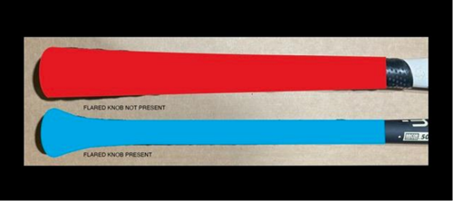
Bats Article 2 to 4 2-c1 Point of Emphasis for 2025
Art 2-b1 The bat knob shall protrude from the handle. The knob may be molded, lathed, welded or permanently fastened. Wrappings are permitted except those that cause the knob to become flush with the handle. A one-piece rubber knob and bat combination is illegal.
Art 2-c1 Resin, pine tar or any drying agent to enhance the hold are permitted on the bat, not to exceed 18 inches from the base of the knob. Molded grips are illegal. ***Point of Emphasis for 2025
Art 2-d Bats that are not made of a single piece of wood shall meet the Batted Ball Coefficient of Restitution (BBCOR) performance standard, and such bats shall be labeled with a silkscreen or other permanent certification mark. No BBCOR label, sticker or decal will be accepted on any non-wood bat. The certification….will read BBCOE .50
Art 4…only bats may be used in warming up (including weighted bats used for this purpose) at any location. Only bats and items designed to remain part of the bat, such as weighted bats, batting donuts, and wind-resistant devices are legal at any location.

Slide 10
Bats Section 2 Article 5
Art 5… Bats that are altered from the manufacturer’s original design and production, or that do not meet the rule specifications, are illegal(7-4-1a). No artificial or intentional means shall be used to control the temperature of the bat. No foreign substance may be inserted into the bat. Bats that are broken, cracked or dented or that deface the ball, i.e. tear the ball, shall be removed without penalty. A bat that continually discolors the ball may be removed from the game with no penalty at the discretion of the umpire.
There is no replay or coach option nor penalty. Remove the bat; log it in the score book and on the PU lineup card. Next notify (not warn-restrict-eject) the offending HC. If the bat reappears in the game, it will be treated under the illegal bat rule.

Slide 11
Gloves and Helmets Article 6 and 7
Art 6… Catcher’s mitt…may only be worn by the catcher and may be of any size.
Pitcher’s Glove…. The glove/mitt worn by the pitcher that includes the colors white and/or gray shall be removed from the game upon discovery by either team and/or umpire.
Art 7… Loose equipment, such as gloves, bats, helmets or catcher’s gear, of either team may not be on or near the field.
Penalty: If loose equipment interferes with play, the umpire may call an out(s), award bases or return runners, based on the umpire’s judgement and the circumstances concerning the play.

Slide 12
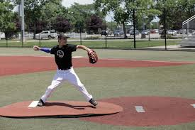
Pitcher’s Uniform Section 4
Sleeve. if the pitcher wears a sleeve extending below the elbow on his pitching arm, it must not be white, gray or deemed not distracting. Note: he may wear a white or gray sleeve; but not below his elbow.
Logo…The pitcher is not allowed to have a white nor grey logo visible below his pitching arm’s elbow. The logo may be blacked out to meet this guideline.
Compression. NFHS 2014 rule interpretation provides the pitcher may not wear a white or gray compression type sleeve extending from his bicep to his wrist on his non-throwing arm. He is NOT required to wear sleeves on both arms.
Vest Type Jersey. Viewed as a type of uniform top and not an undergarment. If the team has a white or grey top that extends below the elbow, it is permissible for the pitcher to wear a color different than the rest of the team. (inter. Hopkins, 2009).
Undergarment Sleeves. Need not be same color as other team members and do not have to match but must be of same length and not frayed. Never white, gray nor distracting to the batter.
Sweat band, tape or band aid. Not to be displayed on the pitching arm/hand. Legal on other arm as long as it is not white, gray nor deemed not distracting to the batter. UIC will decide what is distracting. CUA policy is no sweatband either arm.
Jacket. Pitcher may only wear a jacket while on offense, never on the defense.
Legal-black compression on throwing arm
Illegal because of the size not location of logo

Slide 13
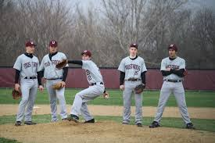
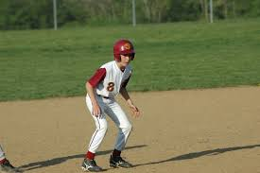
Player Uniform Section 4
Caps and shoes…required. Cap must be worn correctly.
Compression sleeve. NFHS does not consider a compression sleeve as an undergarment. They are considered medical sleeves. Therefore, ANY compression sleeve does NOT fall under the undershirt guidelines.
Compression sleeves, since not part of the jersey or undergarment, may be of any color and a player may wear one on either or both arms.
Sleeve logo/trademark. A sleeve of any type may not have a manufacture’s logo or trademark showing larger than 2.25 sq. inches x 2.25 sq. inches.
Undersleeves worn without vest type jersey. NCHSAA will allow a player (other than the pitcher) to wear on his throwing arm undergarments of white, gray or a non-distracting color. Players are not required to wear matching under sleeves. Must not be frayed and of equal length per player not per team.
Undersleeves worn with vest type jersey. NCHSAA follows the NFHS requirements. The shirt under the vest is considered to be part of the uniform top and not an undergarment .Exception: see pitcher’s uniform.
Traditional jersey with undergarment
Vest type jersey

Slide 14
Player Equipment –Helmets Section 5 Article 1 and 2
Art 1… It is mandatory for on-deck batters, batters, runners, retired runners, players/students in the coaches boxes as well as non-adult bat/ball shaggers to wear a batting helmet that has a non-glare (not mirror-like) surface and meets the NOCSAE standard at the time of manufacture….
PENALTY: When an umpire observes anyone who is required to wear a batting helmet deliberately remove the batting helmet while in live-ball territory and the ball is live (non-adult ball/bat shaggers required to wear a batting helmet in live-ball territory even if ball is dead), the umpire shall issue a warning to the coach of the involved team, unless the ball becomes dead without being touched by a fielder or, after being touched a, goes directly to a dead-ball area. A subsequent violation of the rule will result in ejection.
Art 2… A face mask/guard may be attached to batting helmets at the time of manufacture. A face mask/guard specifically designed for a particular helmet model may be attached after manufacture, provided that procedure is approved by the manufacturer and meets the NOCSAE standard at the time of manufacturer.
Illegal helmets. Cracked or tapped over helmets compromising the structural integrity of the helmet are not allowed. CUA ONLY. Remove the helmet. Follow the CUA written warn, restrict, eject procedure. If the helmet reappears again in the game, remove the helmet and continue with the procedures next step.

Slide 15
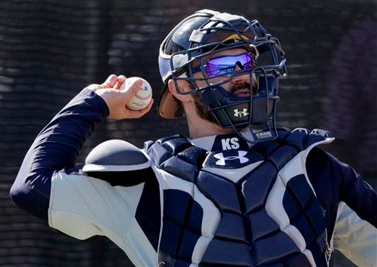
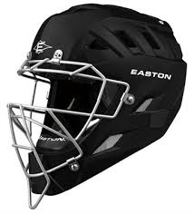
Player Equipment- Catcher Section 5 Article 3 and 4
Art 3… The catcher shall wear , in addition to a head protector, a mask with throat protector, body/chest protector that meets the NOCSAE standard at the time of manufacture, protective cup, and baseball shin guards
Catcher’s helmet/mask…look for the NOCSAE standard label. The mask does NOT have to be a one- piece construction (hockey style mask); but it must be of a helmet style providing full double ear protection. Skull cap only are not allowed. Apply warn-restrict-eject.
illegal- no double ear protection
legal

Slide 16
Player Equipment Section 5
Illegal helmets. Cracked or taped over helmets compromising the structural integrity of the helmet are not allowed. Remove the helmet. Follow the CUA written warn, restrict, eject procedure. If the helmet reappears again in the game, remove the helmet and continue with the procedures next step.
Art. 9… Any player equipment judged by the umpire to be unreasonably dangerous is illegal
Art. 10… Any questions regarding legality of a player’s equipment shall be resolved by the umpire-in-chief

Slide 17
Player Equipment –PLAYER COMMUNICATION EQUIPMENT Section 6
ART 1… Any wristband with defensive shifts/offensive plays/pitching choices or game directions shall be considered non-electronic equipment and is permitted as long as it is a single, solid color. For pitchers, it may not contain the colors white gray or be distracting. It does not have to match the color of the uniform or the sleeves worn underneath the uniform jersey. It shall only be worn on a player(s) wrist or forearm and pitchers shall wear it on their non-pitching arm.
PENALTY: The umpire shall issue a team warning to the coach of the team involved and the next offender(s) of that team will be ejected along with the head coach. ** Use the announcement of lineups when players come to the foul line to help prevent this if possible.
Art 2… One-way electronic communication devices are permissible from the dugout to the catcher while the team is on defense for the purpose of calling pitchers. When using the electronic communication device, the coach cannot be outside the dugout/bench area.
PENALTY: The umpire shall issue a warning to the coach of the team involved and the next offender(s) of that team will be ejected along with the head coach.
***In North Carolina for 2025 the pitcher may also have a device.

Slide 18
NCHSAA Policies for Player Equipment
.
Eye black. Eye black in NC is only allowed as one short straight line approximately ½ inch wide placed directly under the eye socket. The pitcher is allowed to wear eye black. NCHSAA has a minimum two (2) week suspension for any umpire not enforcing correct eye black policy. Handle it before the game if possible. Observe dugouts and especially lineup announcements when they come to the foul line.

Slide 19
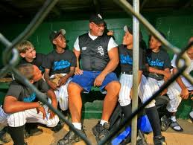
Coach’s Dress Code
HC and any assistant coach occupying a coaching box must be dressed in a similar fashion to the players. Varsity coaches are expected to wear some item of clothing such as a jersey or team jacket to distinguish them as part of the coaching staff. Street clothes, sweat suits or casual wear are not to be allowed by any coach who occupies a coaching box. NCHSAA does not allow a coach to be in jeans or shorts. Sweatpants with jersey top or team jacket is permissible. Any coach not properly attired, is not allowed on the field of play, nor allowed to attend pre-game conference. They will be restricted to the dugout. Coaches also are permitted to conduct charged conferences from their team dugout. (CS 3.2.1f). Exception: Restricted coaches may enter the field of play to attend to an injured player or assist in crowd control, or to break up a fight. Game report should include dress code violation since it involves a restriction. This type of restriction is not a penalty. NCHSAA does not consider this type restriction to be HC’s first warning toward ejection. Follow standard ejection policy as outlined in this guide. The coach may occupy a coaching box once proper clothing has been displayed.
Illegal even for assistant
Illegal or legal?
LEGAL!...note his location. Keep him there

Slide 20
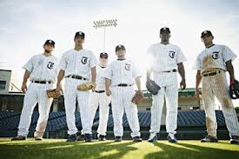
Conclusion
Questions?
Notes:
Many answers to question concerning illegal equipment may be found in the Policy handbook guide.

